Slide 1
Node-RED – WoT-Discovery Integration and Thing Orchestration
Kunihiko Toumura
2021.10.11

Slide 2


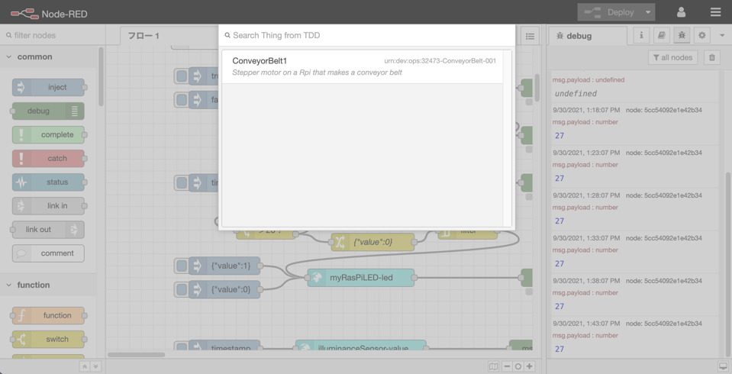

Node-RED – WoT Discovery Integration
We updated a query interface on Node-RED WoT-Discovery plugin so that it can query TDD using SPARQL.
PREFIX td: <https://www.w3.org/2019/wot/td#>
PREFIX dc: <http://purl.org/dc/terms/>
SELECT DISTINCT ?id ?title ?desc
WHERE {
?id a td:Thing;
dc:title ?title;
dc:description ?desc.
dc:description|dc:title ?desctitle
FILTER(contains(lcase(str(?desctitle)), lcase("${req.body.query}”))).
}
LIMIT 100
Node-RED
Integrated
Query interface
Things
Thing
Description
Directory
Sync script
Collects
TDs and
convert to RDF triple
Retrieve TDs
using
SPARQL
Query
Generating
Node from TD
(Node Generator)
Siemens/Logilab

Slide 3
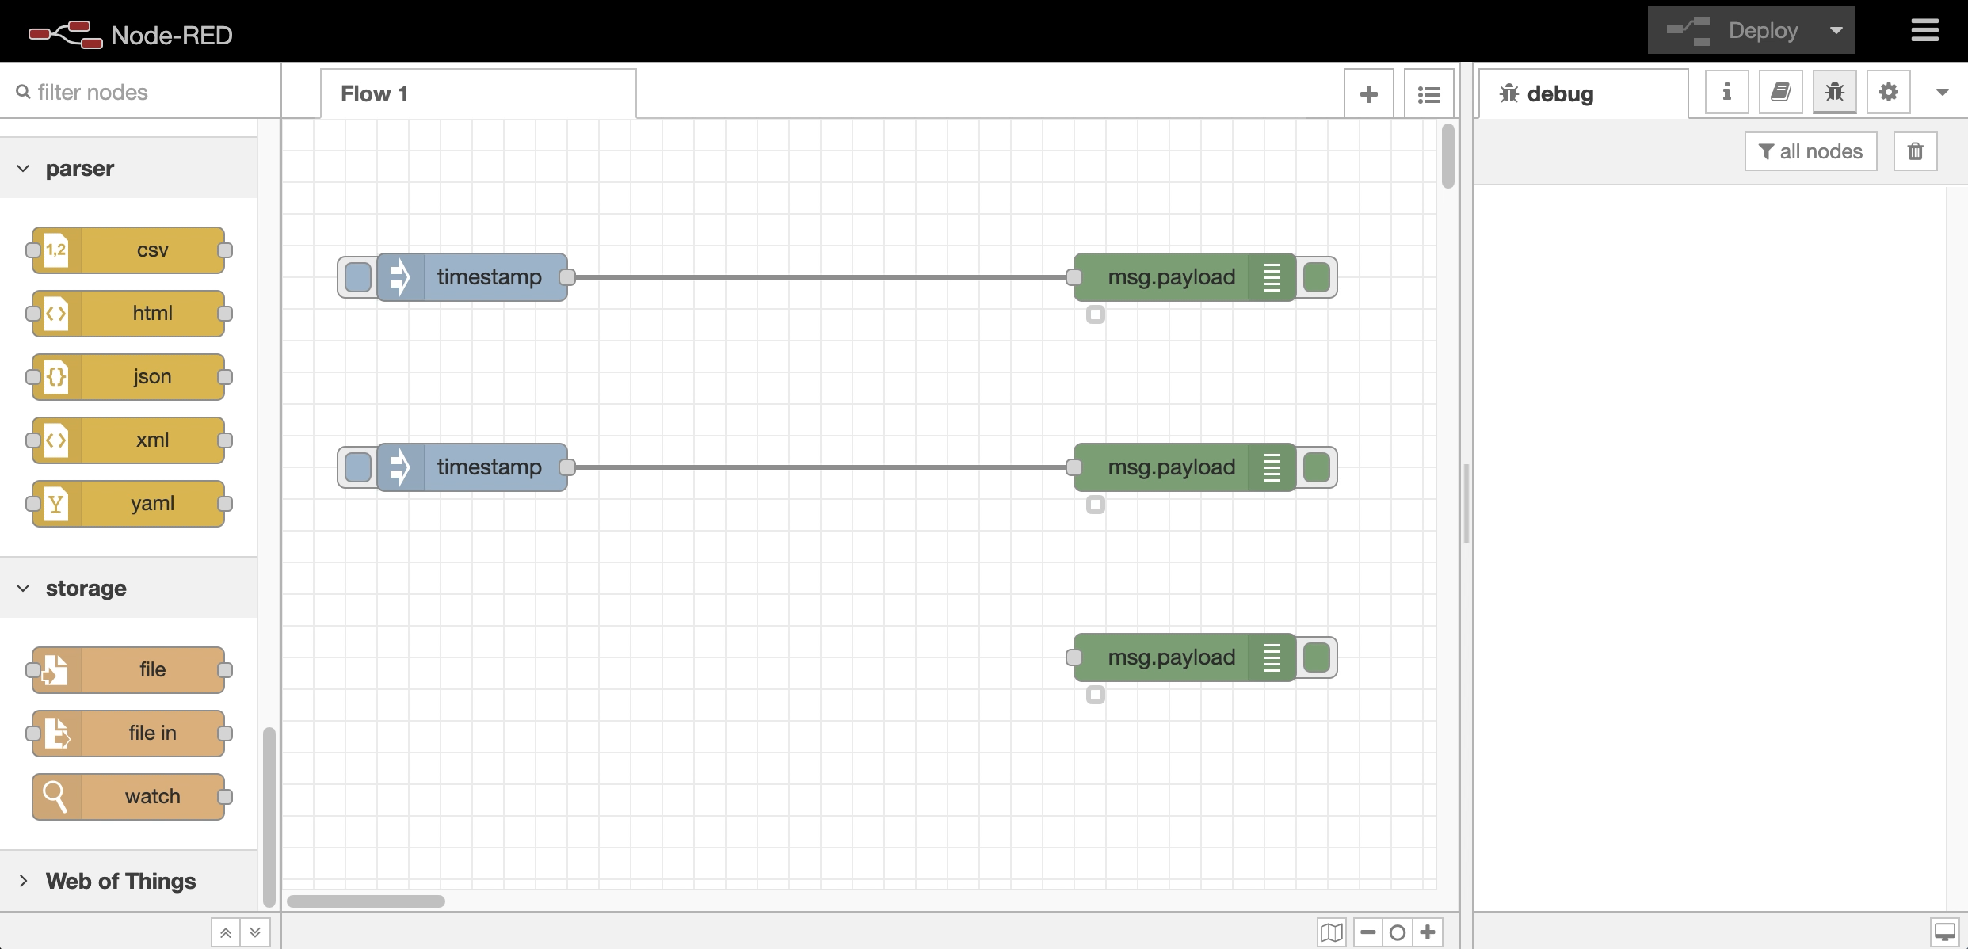

Slide 4
Issues / Discussion / Lessons Learned
Round-tripping issues
Invalid securityDefinitions ( w3c/wot-thing-description#1193)
title and description are converted to titles and descriptions
Node generator assumes that all TDs have a title.
hrefs in forms are renamed to hasTarget.
Correct @context and @type are needed to register a TD to TDD.
Need a better search UI that leverages the power of SPARQL
The current implementation simply does a keyword search of description in TD.

Slide 5
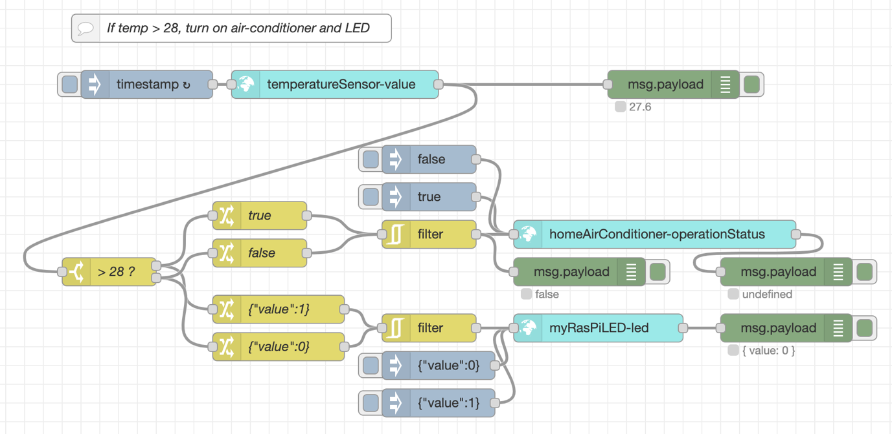
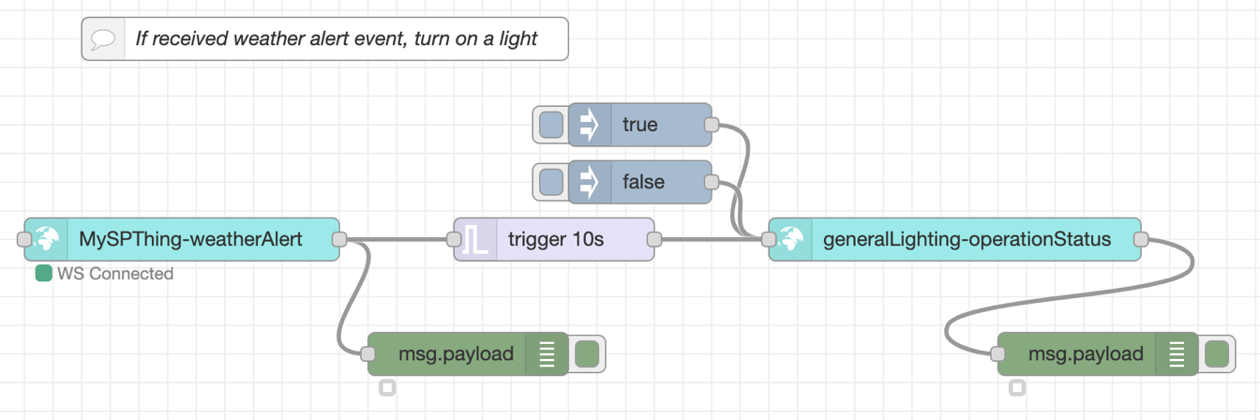
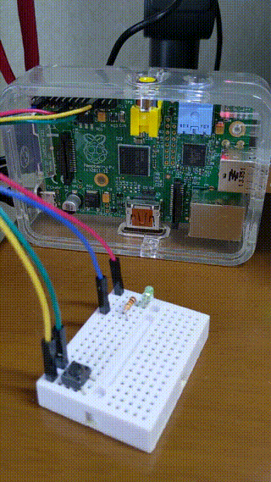
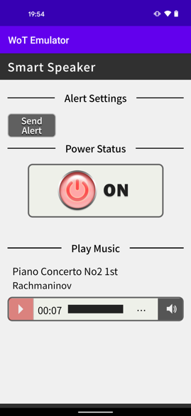
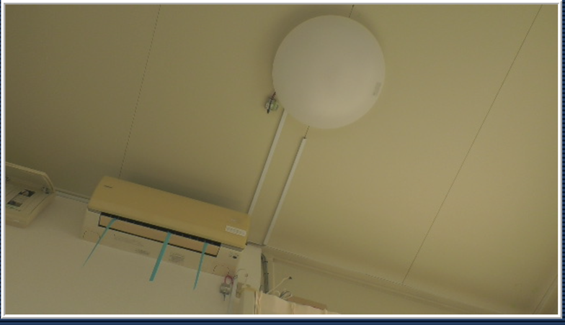

Orchestrating Things using Node-RED
Thermostat
Visual alert
ECHONET Sensor
NHK Smart Speaker
Hitachi LED
ECHONET Aircon
ECHONET Light

Slide 6
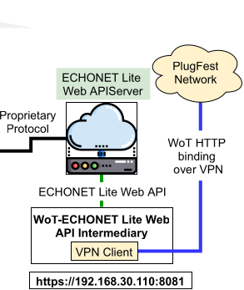
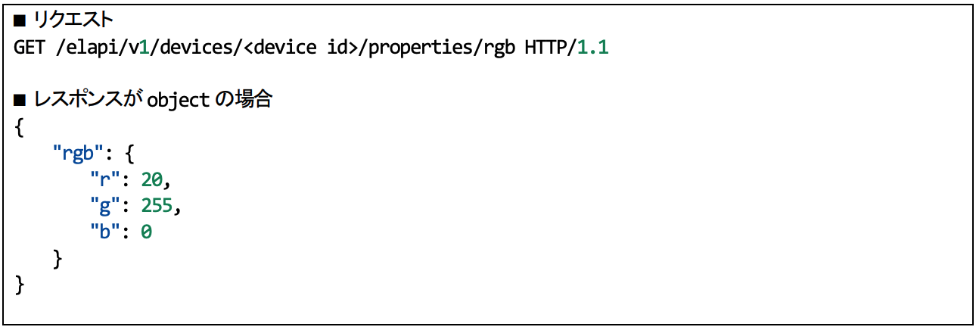
Issues / Discussion / Lessons Learned
Direct access to ECHONET Lite web API
In this plugfest, we can access ECHONET device via gateway (WoT-ECHONET Lite Web API Intermediary).
Gateway removes an encapsulating object from a response payload.
If we describe ECHONET Lite Web API using TD, we can also directly access to ECHONET Lite Web API.
Between DD and TD, the scope specified by each schema is different. By adding the encapsulating object schema when converting DD to TD, it is possible to access ECHONET Lite Web API directly … ?
{“rgb”: {“r”:20,”g”:255,”b”:0}}
(request)
(When the response is object)
ECHONET Lite Web API Device Description (DD) describes the schema of this part
WoT Thing Description (TD)
describes the schema of this part
{“r”:20,”g”:255,”b”:0}
https://github.com/w3c/wot-testing/blob/main/events/2021.09.Online/Projects/ECHONET/20210917_Plugfest_ECHONETControllerUpdated.png
https://echonet.jp/wp/wp-content/uploads/pdf/General/Download/web_API/ECHONET_Lite_Web_API_Specs_v1.1.3.pdf

